Slide 1
Software project
management
Risks In

Slide 2
INTRODUCTION
MUHAMMAD MUSA KHAN
BSCS-F19-M-B-61
SECTION (B)

Slide 3
DOMAIN
introduction
Risks play an important role in Software project Management. We have to deal with uncertain events of the software project and their causes.To predict the uncertainty software risk is not easy. The software project managers can use these lists as identification check lists to identify the risk that may relate to their software projects.

Slide 4

User
User resistance to change
Conflict between Users
Users with negative attitudes toward the project
Users not committed to the project
Lack of cooperation from users
The person or organization that will use the project's product or service

Slide 5



Requirements
Continually changing requirements
System requirement not adequately identified
Unclear system requirements
Incorrect system requirements
The process of defining, documenting and maintaining the requirements

Slide 6



Project
complexity
Project involves the use of new technology
High level of technical complexity
Immature technology
Project involves the use of technology that has not been used prior project
Project complexity is the property of a project which makes it difficult to understand

Slide 7
PROJECT PLANNING AND CONTROL
Lack of effective project manage technology
Project progress not monitored closely enough
Inadequate estimation of required resources
Poor project planning
Project mile stone not clearly defined
Inexperience project managers
Project Planning and Control protects your project from risk and will ensure it stays on track for delivery, even when things change during the project's life-cycle.

Slide 8
team
Inexperience team members
Inadequately trained developmentteam members
Team members lack of specialized skill required by the project
The project team is the group of people, responsible for executing the tasks, and producing deliverables outlined in the project plan and schedule, as directed by the project manager

Slide 9
Organizational environment
Change in organizational management during the project
Corporate politics with negative effect on the project
Unstable organizational environment
Organization under going restructuring during the project
The organizational environment is the set of forces surrounding an organization

Slide 10
Literature review
 | Name | Author
[1] | Software Project Management 4th ed, pp.147, 1996, McGraw-Hill (UK). | B. Hughes, and M. Cotterell
[2] | “Software Project Risk and their Effect onOutcomes”, Communication fo the ACM, vol 47 number 4, pp. 68-73,2004 | L. Wallace and M. Keil
[3] | “Portfolio approach to information systems” HarvardBusiness Review, vol 59, number 5, 1981, pp.142-150 | F. MCFarlan
[4] | “Software Risk Management: Principles and Practices”,IEEE Software vol 8, number 1, pp.32-41,1991 | B.W. Boehm
[5] | “E-Commerce Project Development Risks: Evidencefrom a Delphi survey”, International Journal of InformationManagement vol 23, number 1, pp. 25-40, 2003 | T. Addision

Slide 11

methodology
In our research paper, reascher was eager to find the answer that which are top risks in software project management that can affect our software project in a bad manner.
He studied various authores thoroughly and compared them with each other in order to get the answer of his question.
At the end he is able to make a list in which he wrote top risks and their dimensions which can help any software project manager in their specific project to avoid risks and make their project successful flawlessly.

Slide 12
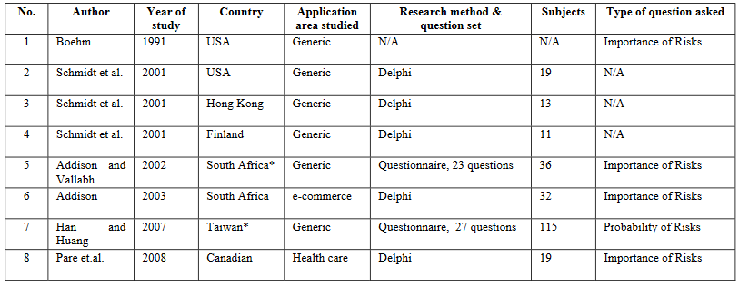
Keep Your Core Message in Mind

Slide 13
Conclusion
To success in managing a software project, project manager needs to understand the nature of software risks.This paper surveys eight top ten software risks lists from the literature.
Author of this research paper have tried his best to make the most important and highly impactable list of risks that can affect any software project.
It is encouraged that an organization should develop its own list from their software project experience.Whereas at the beginning, when an organization has not developed its own lists yet, the top risks lists available in the literature could be helpful

Slide 14
Thank You

